Slide 1
SignalR Silently
The silent movie way – sit back and watch.
Music written by a (late-)deaf composer.
Rob Koch rob@seerobcode.com
Data Scientist/Software Developer at McGraw-Hill Financial
Works with MVC/WebAPI, SSIS, Cube

Slide 2
Introduction
Rob, upon graduating college, entered the working world as an economist, later realized being an economist isn’t economical! It’s software…
You know, how economists always say, “There is no such thing as a free lunch.”
That’s ok, I develop for money so I get food.

Slide 3
Prototyping
Whereas:
Build a website showing status of what’s happening.
Whatever happens, folks have a need to know.
That way, they may take action if a certain status happened, or for peace of mind.

Slide 4
Tools used (any sounds familiar?)
SQL Server
Visual Studio 2013
C#
JavaScript
Knockout
Knockout.mapping
Moment.js (for date formatting)

Slide 5
Demo
What this does:
Query the database every 10 seconds for updates
Show updates on screen
Everyone is in the know
A status is randomly generated between 1 and 10 seconds.

Slide 6

Works great, people happy!

Slide 7
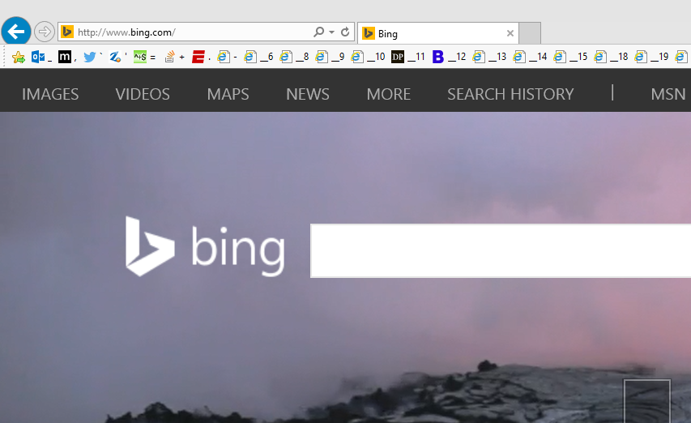
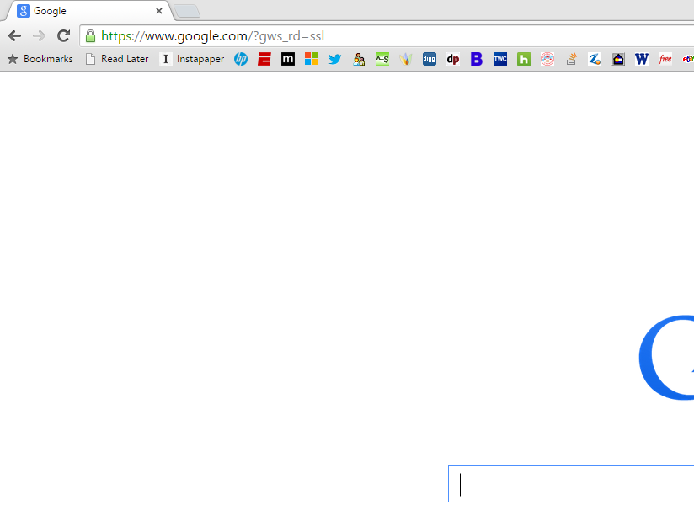
More rubberneckers gets on…

Slide 8
Think we got a problem?
Naw!
Disclaimer: the cat is not harmed in this shoot.

Slide 9
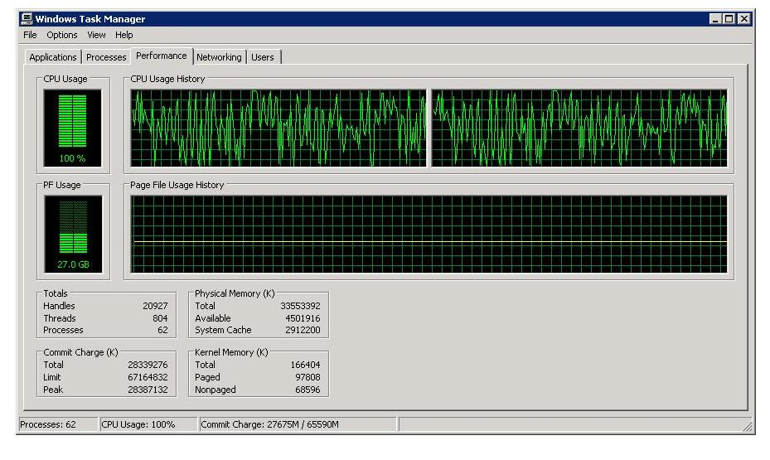
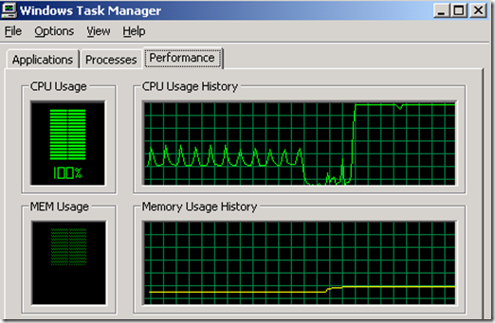
DBA comes to me…
What did you say? My app? What?

Slide 10

Boss
I typically read lips, but when he is angry, I don’t understand him.

Slide 11
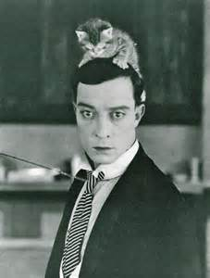

Slide 12
Re-evaluate life as a developer
Along comes SignalR!
My kind of thing: has S-I-G-N in it’s name too.
Broadcasts real-time
WebSockets protocol, but has fallback protocol for older browsers or bad network
Like the web, it’s STATELESS!
Let’s build with SignalR

Slide 13
Demo SignalR

Slide 14
References
http://signalr.net/
http://www.asp.net/signalr/overview/getting-started/introduction-to-signalr
http://tools.ietf.org/html/rfc6455
or email rob@seerobcode.com

Slide 15
Thanks
Jerry Nixon/Microsoft
Crystal Long
The good folks at McGraw-Hill Financial
Sponsors of Denver Dev Days
My wife & family for their support
Whomever I forgot to name (sorry!)
And…..
YOU!

